Slide 1
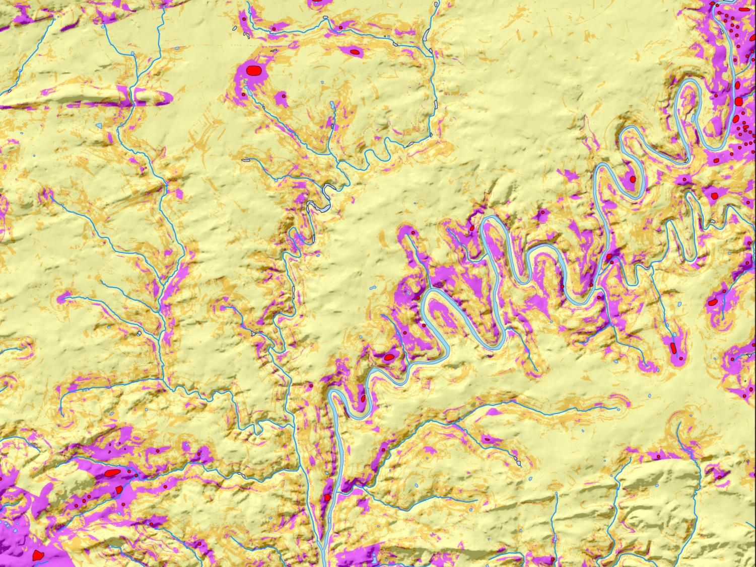



Pennsylvania Predictive Model Set:
Realigning Old Expectations with New Techniques in the Creation of a Statewide Archaeological Sensitivity Model
Matthew D. Harris, AECOM
Grace H. Ziesing, AECOM
SAA 2015, San Francisco, CA.

Slide 2
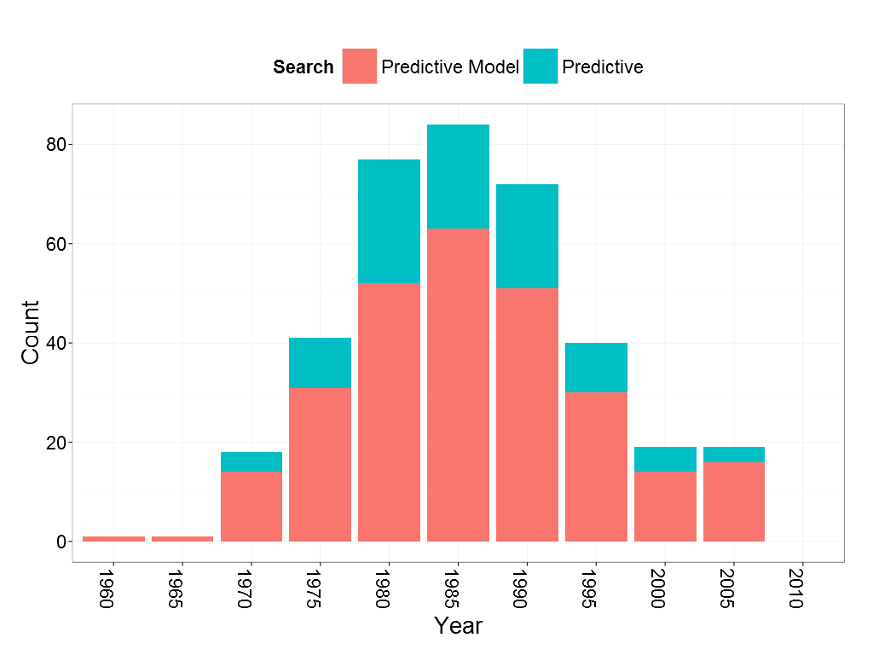
Settlement
Studies
Cultural Ecology
Optimal Foraging
“New” Archaeology
Systems Theory
Predictive
Modeling
1950’s
1960’s
1970’s
1980’s
American Antiquity
Notes:
Historical archaeological perspective
Modern statistical perspective
Focus on empirical predictive accuracy
Reproducibility principles #openscience
Build solid baseline for future studies

Slide 3
Machine Learning Approach
Many goods models, many more bad ones…
Clear goals and model intentions
Iterative learning algorithms for pattern detection
Empirical error estimate through resampling
Letting data speak for itself…
$$Conceptual Model Y=F\left(X\right)+ ε$$
Notes:
Start on history of modeling,
keyword and timeline of research and debate
Only done in MN because of money and academic issues

Slide 4
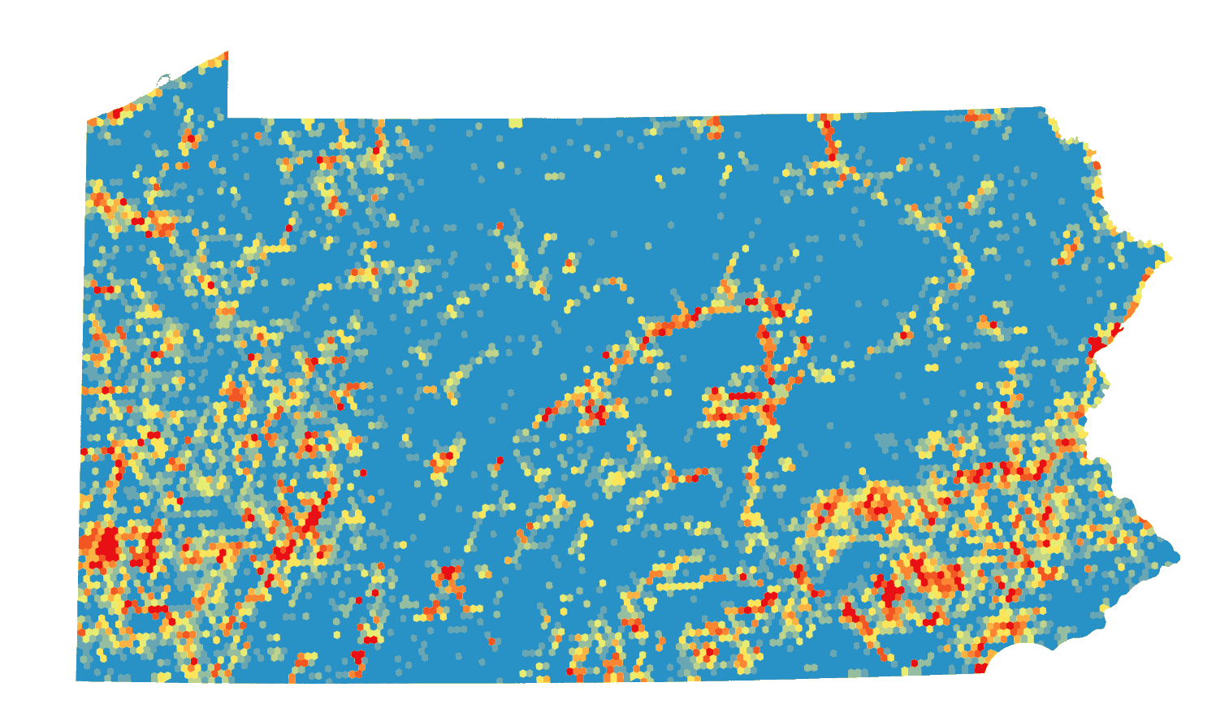
Count of Native American Sites per 1-km
86
5
0

Slide 5



Population Generating Process:
Highly dynamic
Non-mechanistic
Non-stationary
Cultural and agency
Highly dynamic environment
Changing parameters
Subjectively defined expression
Clustered
$$N$$
Sample Generating Process:
Non-systematic
Subjective
Extensive measurement error
Non-representative
Spatially biased
$$n ≈N/0.01$$
$$n ≈18,200$$

Slide 6

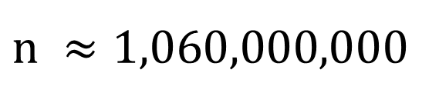
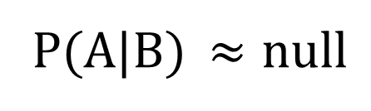

Dataset
Very low prevalence → highly imbalanced
High false-negative cost vs. low false-positive cost
$n ≈1,060,000,$000
Academic Domain
Scant theoretical framework
General lack of validation
No agreed upon benchmarks, or methods
P(A|B) $≈null$
Covariates
Primarily environmental
Co-correlated
Unrepresentative
Limited class separation
$$p ≈93$$
Project
Scalable
Primary constraint is time
Secondary: computer resources
Raster output
Expectations are broad and undefined
$$t ≈18 mo$$

Slide 7
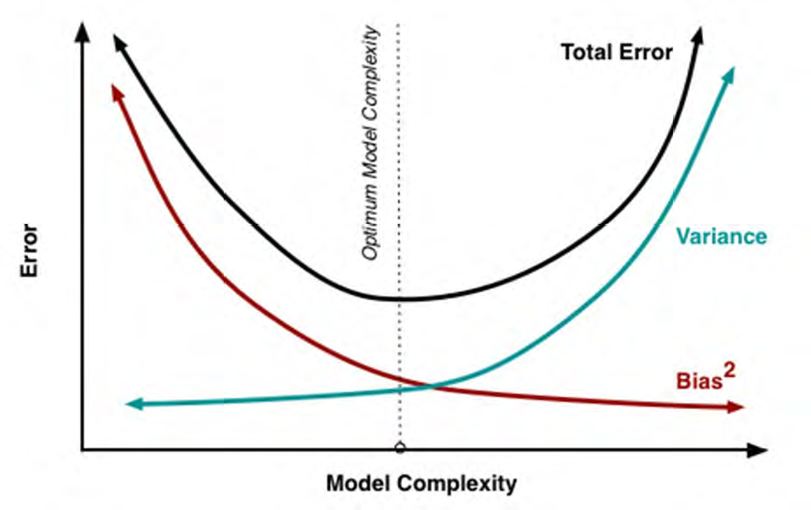
Under fit
Over fit
(d.f., parameters, variables)

Slide 8
Key Takeaways – if you hear nothing after this point:
Not black box – measure twice cut once
Randomize, Resample, Retest
Understand model complexity & Bias vs. Variance
Know your metrics. (AUC, Kvamme Gain, AIC/BIC, Accuracy)
BALANCE in all ways; no one right answer
Class Thresholds are critical and not arbitrary
Cloud based, Backup, practice #openscience
Learn to code. (Excessive ArcGIS will give you hairy palms)

Slide 9
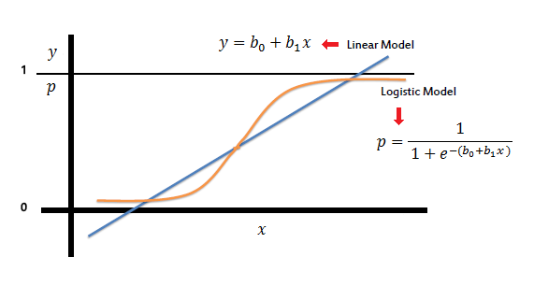

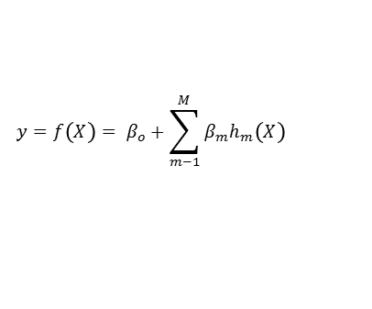




Models
Backwards Stepwise Logistic Regression
Generalized Linear Model w/ binomial link
Lower Complexity = high bias v. low variance
Traditional in archaeology
Parameters: Estimating model coefficients (MLE)
Variable selection: backwards stepwise for AIC
Multivariate Adaptive Regression Splines
Special case of the Generalized Linear Model
Moderate Complexity = variable bias and variance
Unknown to Archaeology, used in Ecology
Parameters: nprune – recursive pruning of terms
Variable selection: Generalized Cross-Validation
$$t_{1}$$
$$y=f\left(X\right)= β_{o}+\sum_{m−1}^{M}{β_{m}h_{m}\left(X\right)}$$
X1
$$h_{1}$$
$$t_{2}$$
$$h_{2}$$
$$t_{3}$$
X2

Slide 10
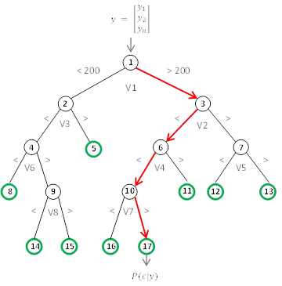









Single Binary Classification Tree
Node-Branch Structure
Node Split Function based on Gini Index
Binary Classification or probability
Generally high variance
$$x$$
$$x$$
…
$$x$$
$${tree}_{1}$$
$${tree}_{2}$$
$${tree}_{b}$$
Random Forest
Bootstrap-aggregating – “Bagging”
Out-of-bag – Unbiased error estimation
Variable Randomization – mtry parameter
Incorporates weights and leaf node size
Sparse examples in archaeology, common elsewhere
…
$${\hat{C}}_{1}=Cat$$
$${\hat{C}}_{2}=Cat$$
$${\hat{C}}_{b}=Dog$$
$$\hat{C}=Cat$$

Slide 11




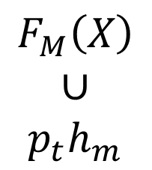













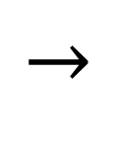


Gradient Boosting
Weak Learners -> Strong Learner
Decision Tree stumps
Each iteration fit to residuals
Adjustable learning rate
$$M_{1}$$
$$M_{2}$$
. . .
$$M_{i}$$
$$x_{1}$$
$$x_{1}$$
$$x_{1}$$
C
D
C
D
C
D
$$x_{2}$$
$$x_{2}$$
$$x_{2}$$
$$F_{M}(X)$$
C
C
C
$$F_{M}\left(X\right)$$
$$∪$$
$$p_{t}h_{m}$$
D
D
D
$\left(y_{i} −E\left[y\right]\right)$
$$x_{3}$$
$$\overset{→}{ψ(y_i, ph(x))}$$
$$x_{3}$$
$$\overset{→}{ψ(y_i, ph(x))}$$
$$x_{3}$$
C
D
C
D
C
D
. . .
. . .
. . .
$$x_{i}$$
$$x_{i}$$
$$x_{i}$$
C
D
C
D
C
D

Slide 12

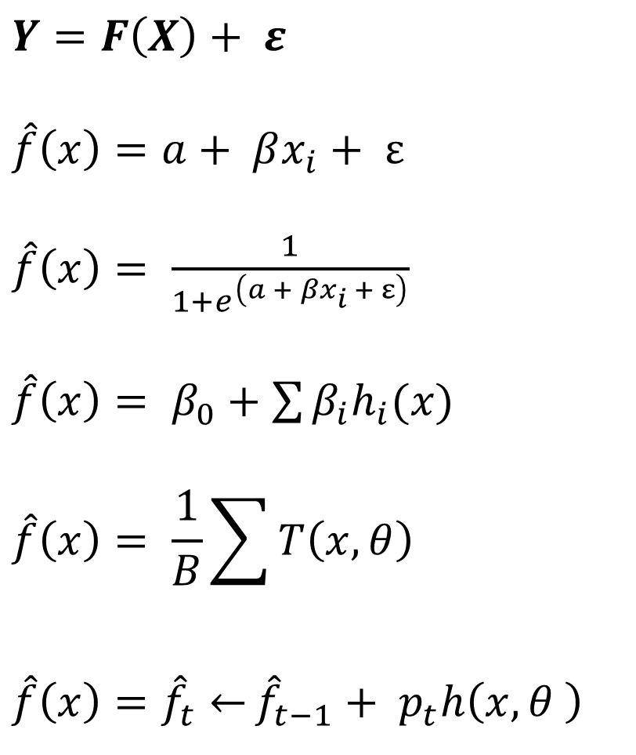




$$Conceptual Model$$
$$Y=F\left(X\right)+ ε$$
$$\hat{f}\left(x\right)=a+ βx_{i}+ ε$$
$\hat{f}\left(x\right)= \frac{1}{1+e^{\left(a + βx_{i} + ε\right)}}$
$\hat{f}\left(x\right)= β_{0}+\sum{β_{i}h_{i}(x)}$
$$\hat{f}\left(x\right)= \frac{1}{B}\sum{T\left(x,θ\right)}$$
$$\hat{f}\left(x\right){=\hat{f}}_{t}\overset{←}{}{\hat{f}}_{t−1}+ p_{t}h\left(x,θ \right)$$
Linear Regression
$$Logistic Regression$$
$MARS Regression$
$$Random Forest$$
$$Gradient Boosting$$
Notes:
Start on history of modeling,
keyword and timeline of research and debate
Only done in MN because of money and academic issues

Slide 13
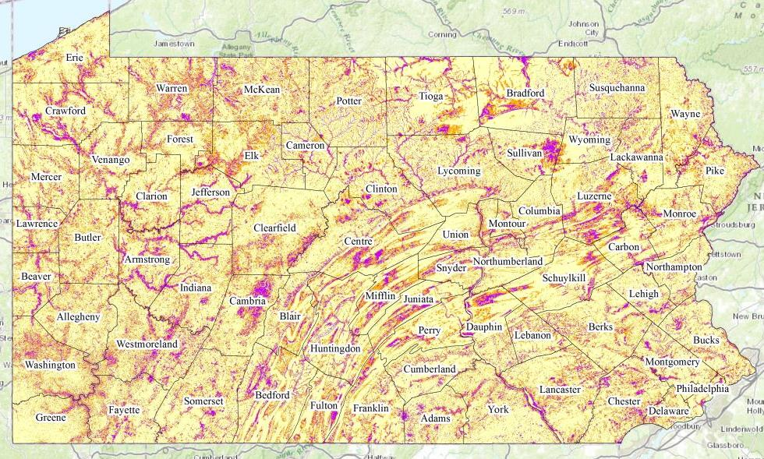



$$High$$
$$Mod.$$
$$Low$$

Slide 14

$$High$$
$$Mod.$$
$$Low$$

Slide 15
 |  | Known Sites
 |  | Present | Absent
Model Prediction | Present | 1,992,770 | 309,213,157 | 311,205,927
 | Absent | 31,472 | 747,684,746 | 747,716,218
 |  | 2,024,242 | 1,056,897,903 | 1,058,922,145
Sensitivity / TPR = |  |  | 98.4%
Specificity / TNR = |  |  | 70.7%
Prevalence = |  |  | 0.0019
Kvamme Gain (Kg) = |  |  | 0.701
Accuracy = |  |  | 70.8%
Positive Prediction Gain (PPG) = |  |  | 3.350
Negative Prediction Gain (NPG) = |  |  | 0.022
Detection Prevalence = |  |  | 0.294
Mean RMSE of hold-out sample = |  |  | 0.181
Total model area (sq. mi) | 45,293 | Individual models | 528
Total model cells (10 x 10 m) | 1 Billion | Environmental variables | 93
Site-present cells | 2 Million | Processed cells | 102 Billion
Archaeological sites | 18,226 | Data | ~ 12 TB

Slide 16
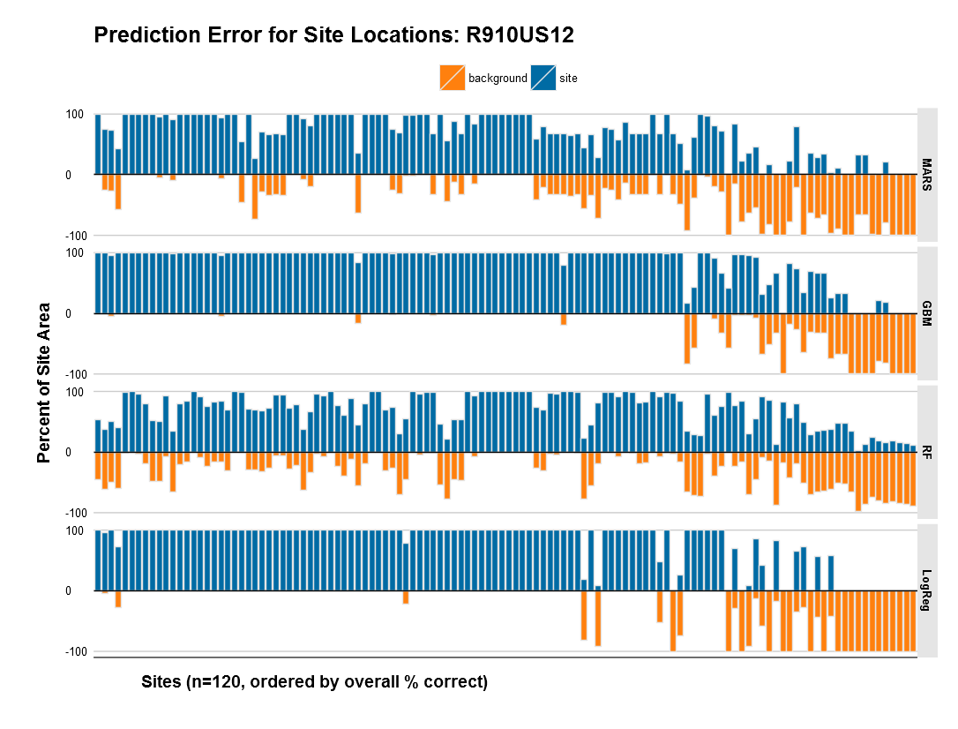

Slide 17
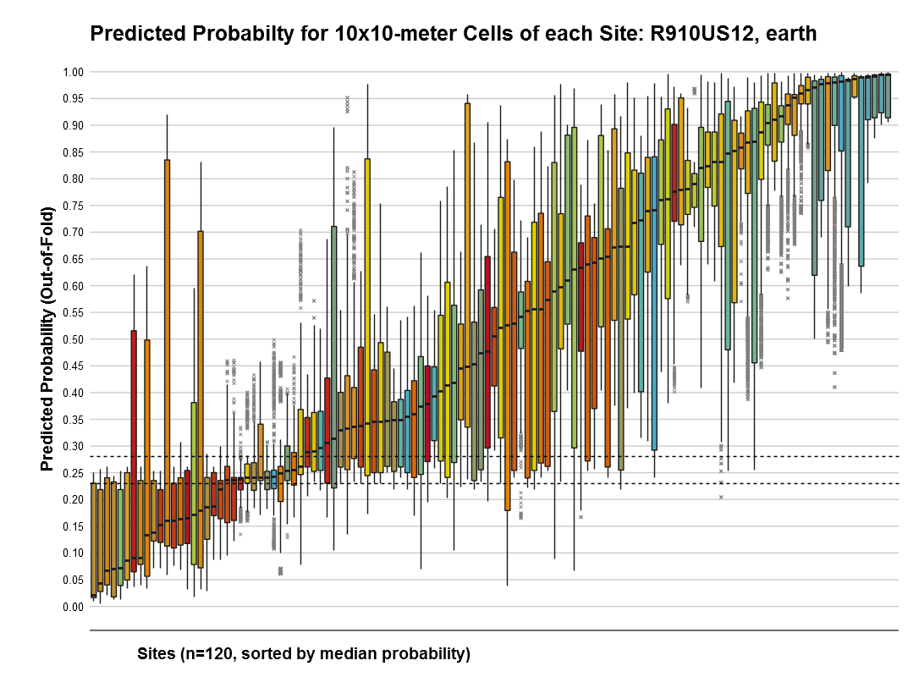
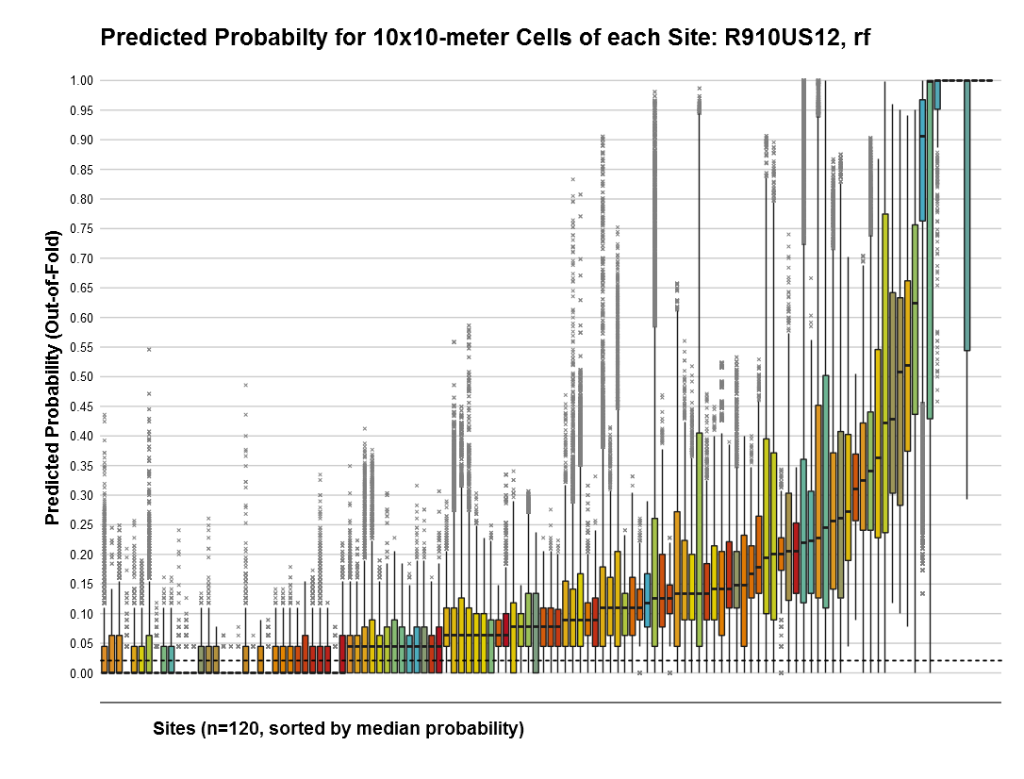
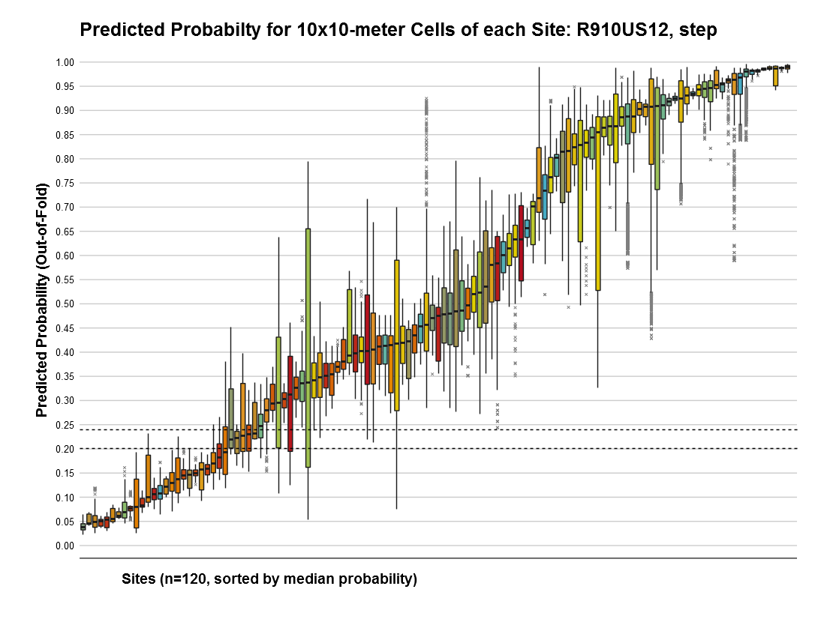
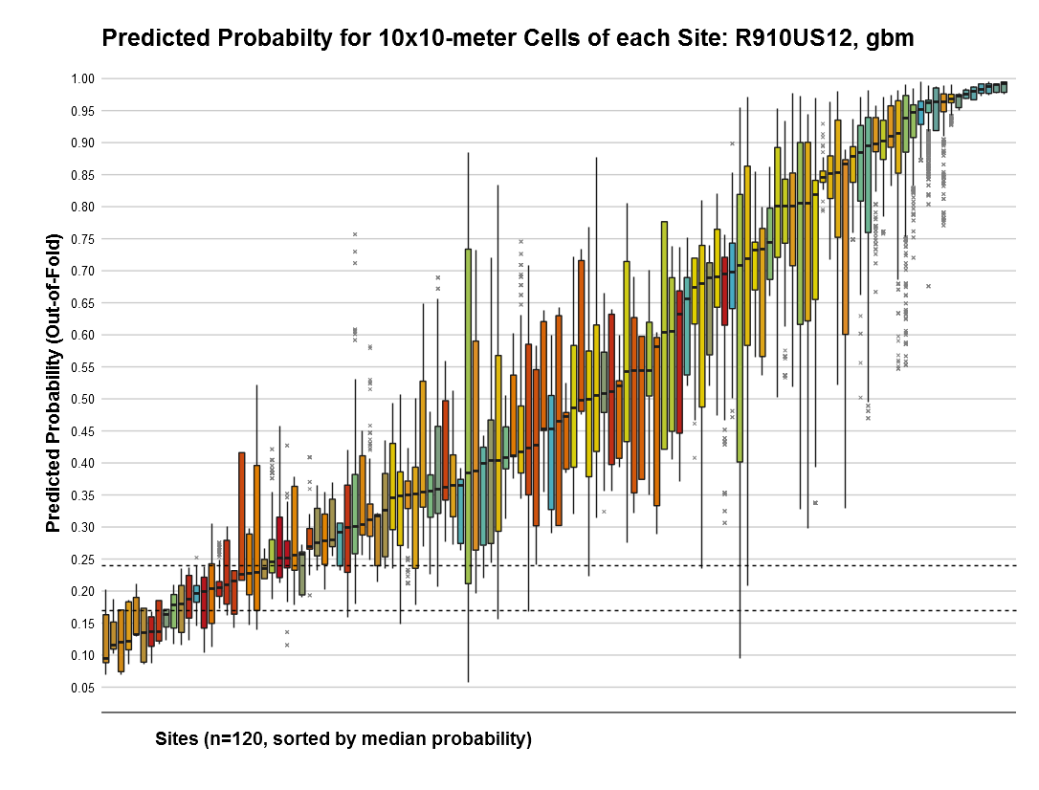
Mars
RF
LogReg
GBM

Slide 18
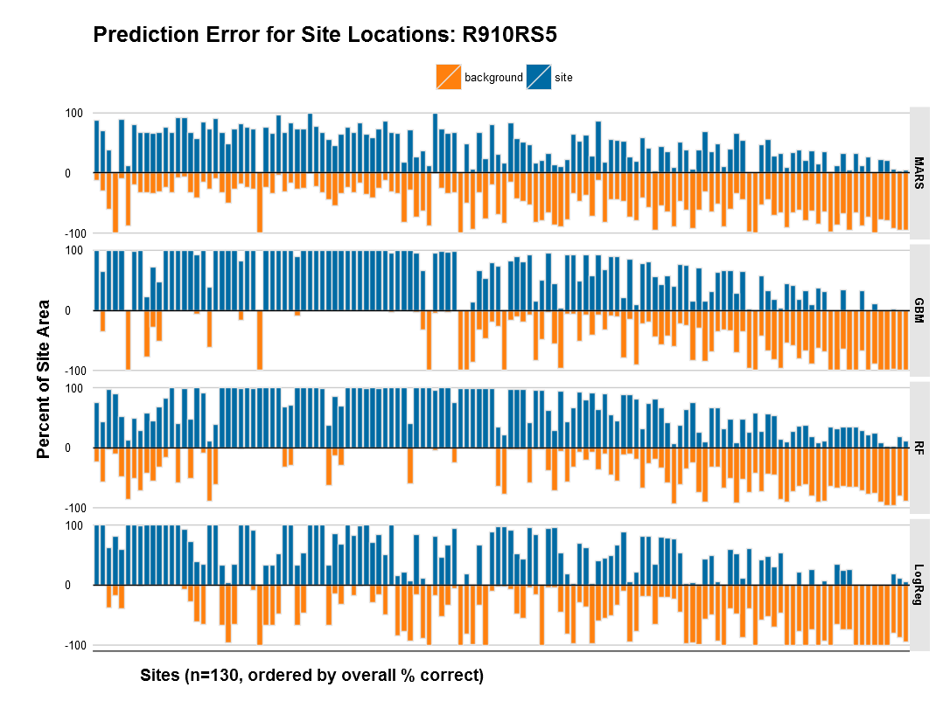

Slide 19
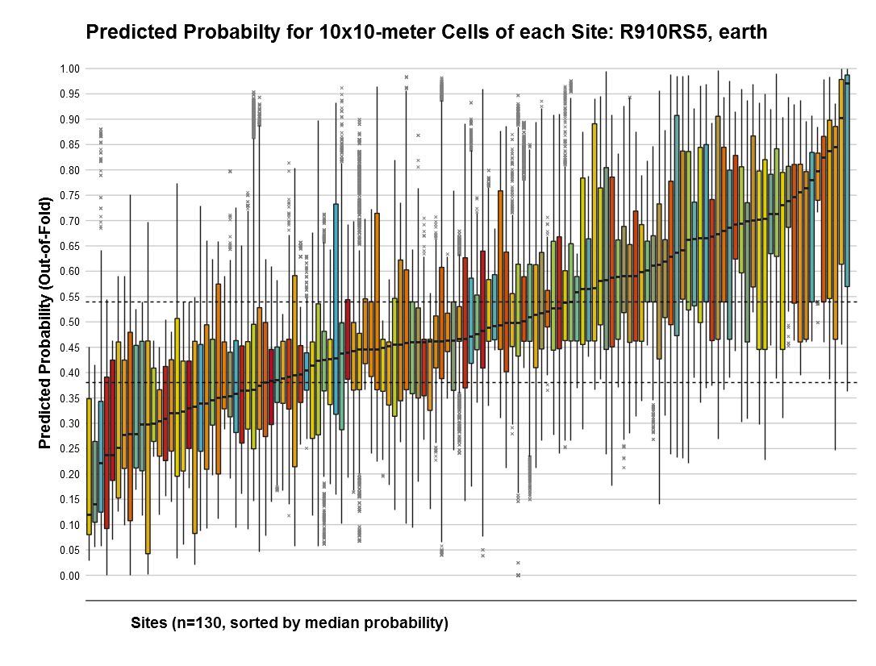
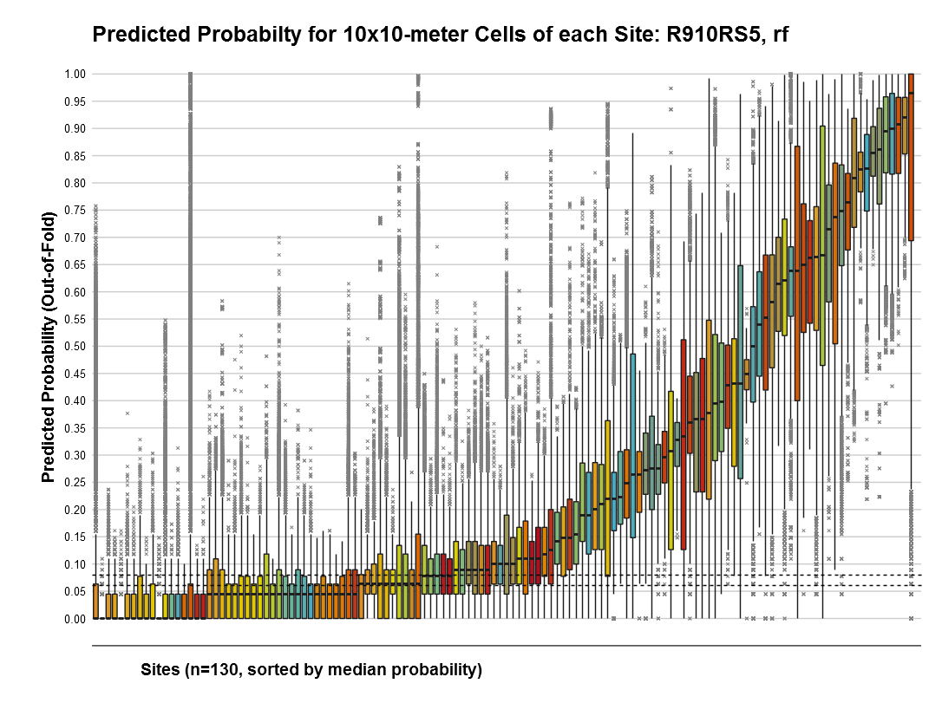
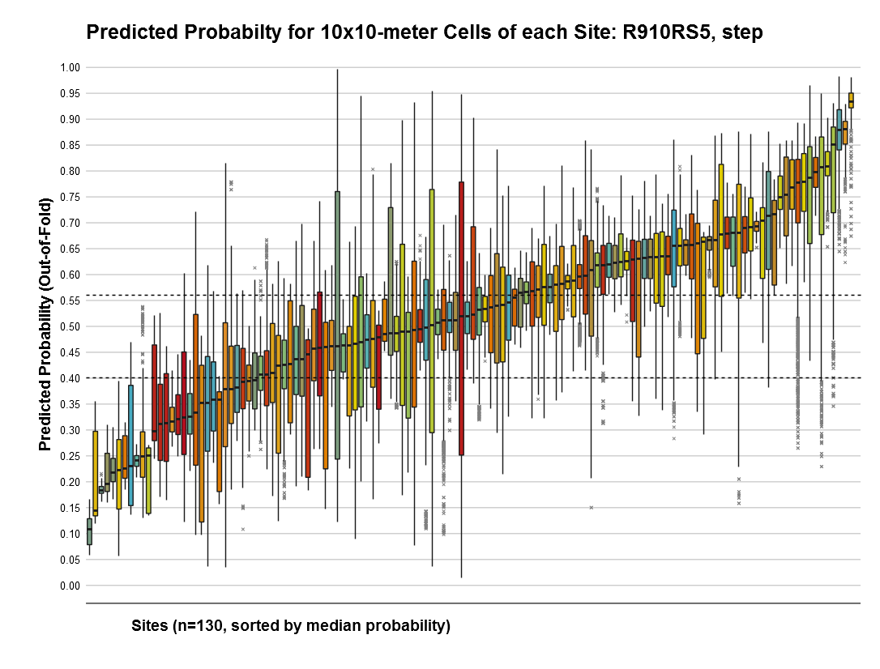
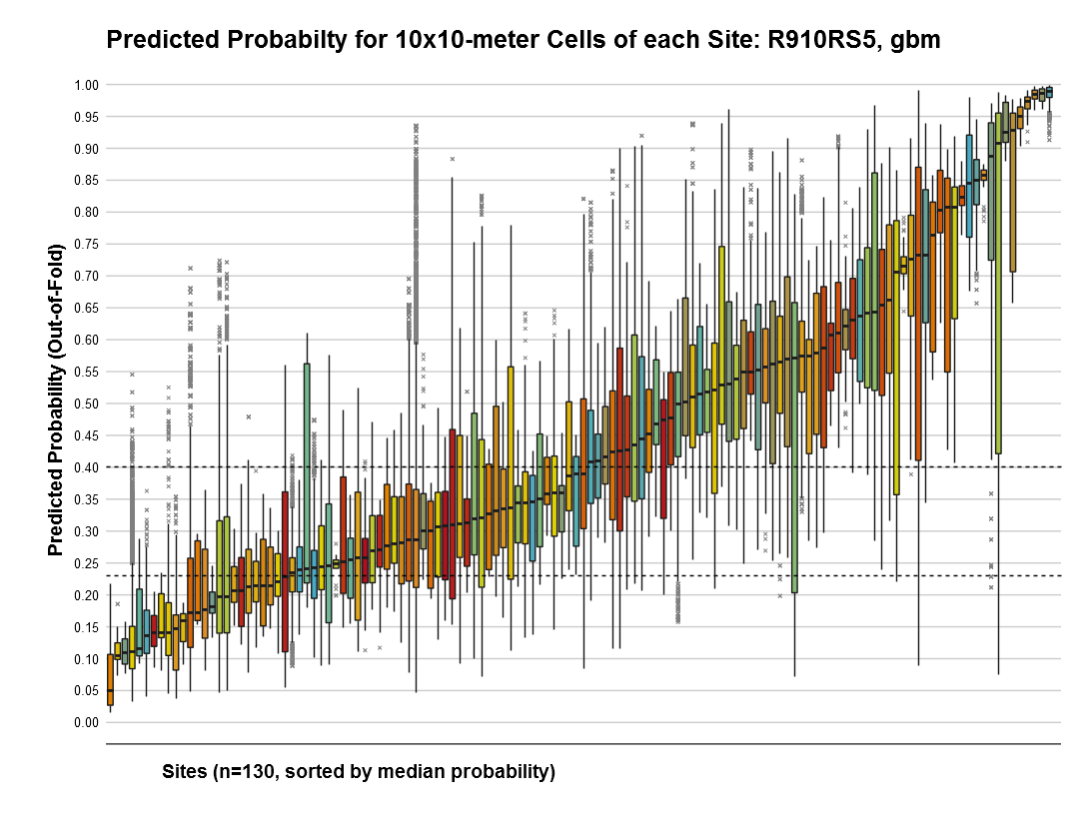
Mars
RF
LogReg
GBM

Slide 20
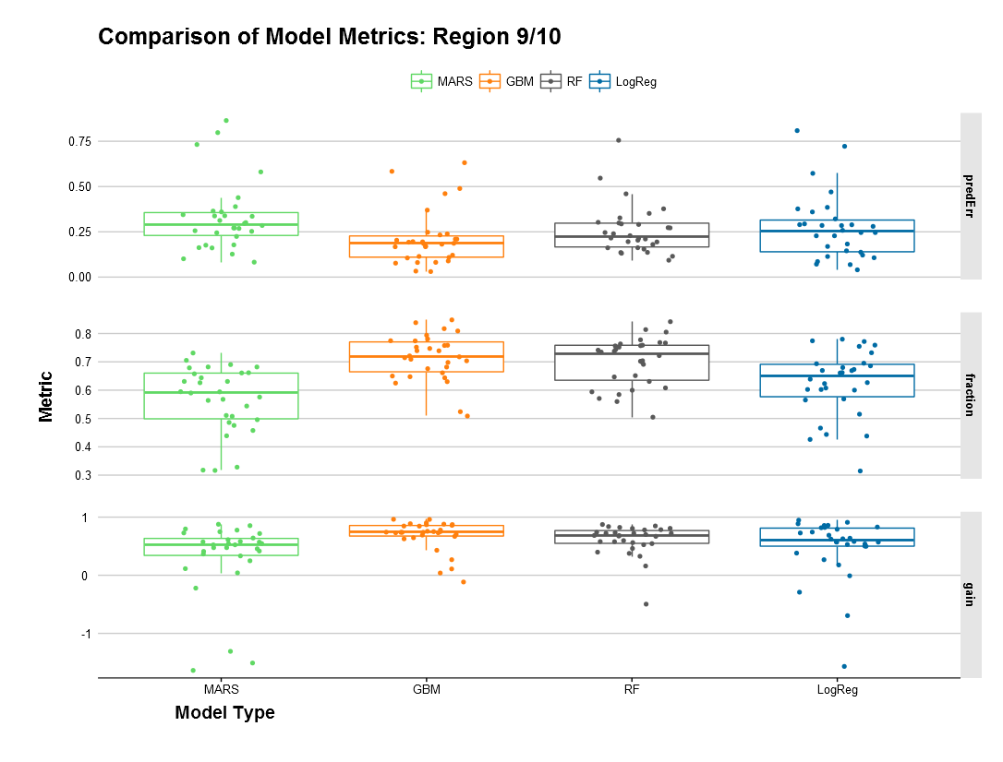

Slide 21
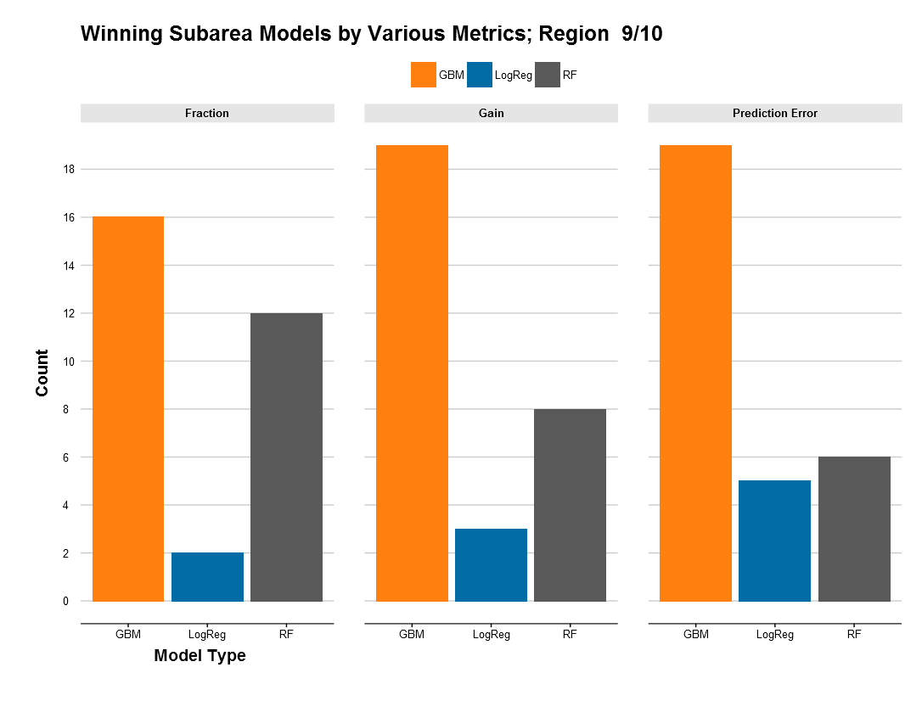

Slide 22
Count of “Winning” Models by each Metric
 | MARS | GBM | RF | LogReg
Prediction Err | 0 | 19 | 6 | 5
Fraction | 0 | 16 | 12 | 2
Gain/Balance | 0 | 19 | 8 | 3
Total | 0 | 54 | 26 | 10
Improvement of “Winning” Models by each Metric
 | Prediction Err | Fraction | Gain/Balance | KG
All Models | 26.8% | 65% | 0.519 | 0.59
Winning Models | 18.3% | 74% | 0.737 | 0.63
Range of “Winning” Models by each Metric
 | Prediction Err | Fraction | Gain/Balance
Best Model | 3.1% | 84.8% | 0.963
Worse Model | 46% | 58.5% | 0.268

Slide 23
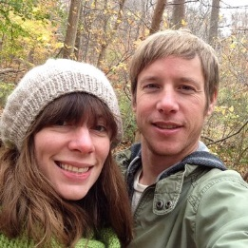
In these samples, sites are not distributed randomly relative to environment; a pattern exists.
  … therefore, predictive modeling “works”.
  … If bias site sample contains pattern.
Data cleaning and preparation is as important as models.
Iterative learning identifies patterns with various levels of bias and variance.
  It’s critical to know your balance.
Parametrization within CV to find candidate models that work.
Repeated resampling approximates probability distribution of each sample. (Bayesian discussion/rant goes here.)
Learn R (or python), practice #openscience, use R Studio and server
Thank You!
@md_harris

